Slide 1
Lecture 9 Transfer Learning & Transformer Learning
CS582
Machine Learning: Getting Computers
to Program Themselves
“Discovering the Learning Dynamics of the Laws of Nature”
Dr. Emdad Khan
ekhan@miu.edu
Prof. of Computer Science
Maharishi International University
May, 2023

Slide 2
Transfer Learning
Improvement of learning in a new task through the transfer of knowledge from a related task that has already been learned.
Weight initialization for CNN
Two major strategies
ConvNet as fixed feature extractor
Fine-tuning the ConvNet

Slide 3
Transfer Learning

Slide 4
Transfer Learning

Slide 5
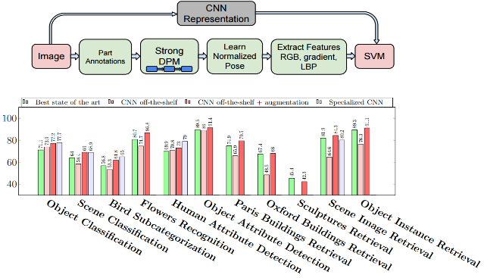
CNN Features off-the-shelf: an Astounding Baseline for Recognition [Razavian et al. 2014]

Slide 6
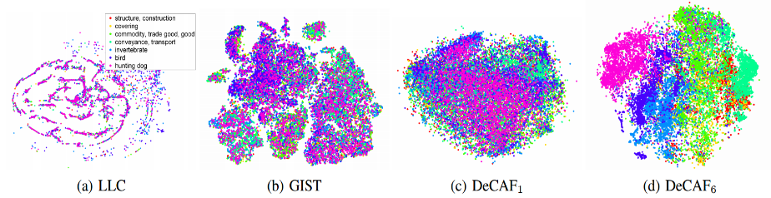
Convolutional activation features
Can Features from CNN be used for Generic Tasks?
Some Common Open Source Convolutional Models with Features
LLC –
GIST- Efficient Data Encoding for Deep Neural Network Training
DeCAF – Deep Convolutional Activation Features
[Donahue et al. ICML 2013]

Slide 7
Transfer Learning

Slide 8
Transfer Learning

Slide 9
When to fine tune your model?
New dataset is small and similar to original dataset.
train a linear classifier on the CNN codes
New dataset is large and similar to the original dataset
fine-tune through the full network
New dataset is small but very different from the original dataset
SVM classifier from activations somewhere earlier in the network
New dataset is large and very different from the original dataset
fine-tune through the entire network

Slide 10
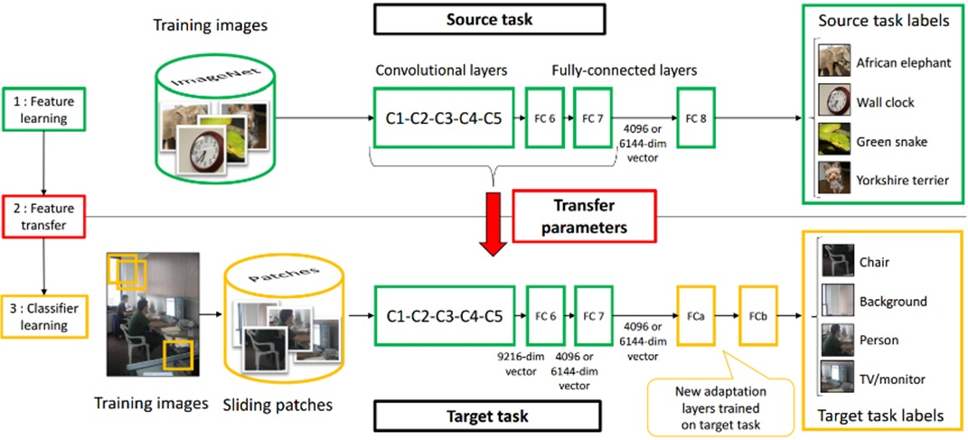
Learning and Transferring Mid-Level Image Representations using Convolutional Neural Networks [Oquab et al. CVPR 2014]

Slide 11
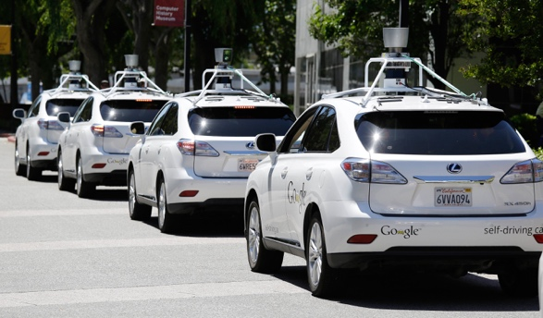
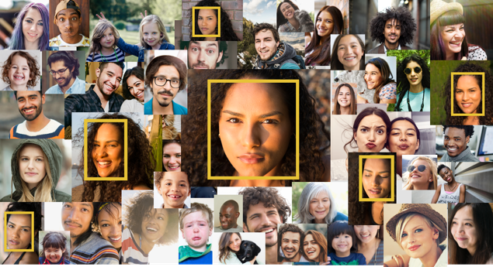


Deep Learning is Data Hungry
High-quality models are trained using large labeled datasets
Vision domain: ImageNet contains over 14 million labeled images
Where do small companies get such large datasets?

Slide 12
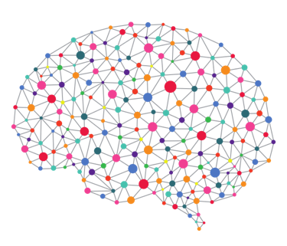



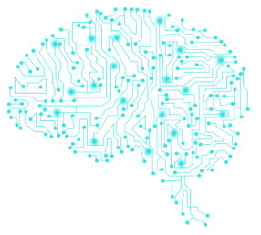
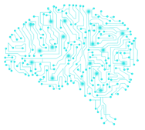
A Prevailing Solution: Transfer Learning
+
Company X
Limited
Training Data
Teacher
Highly-trained Model
Transfer and re-use pre-trained model
Student
High-quality Model
Recommended by Google, Microsoft, and Facebook DL frameworks
Student A
Student B
Student C

Slide 13
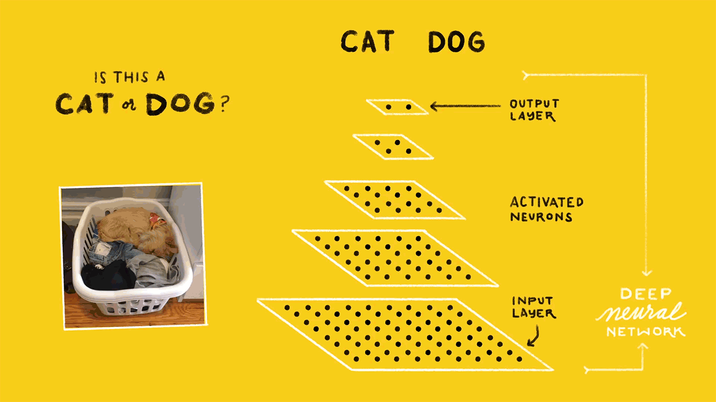
Deep Learning 101
Photo credit: Google

Slide 14



Transfer Learning: Details
Teacher
Student-specific classification layer
Student
Output
Teacher-specific classification layer
Output
Insight: high-quality features can be re-used
$N$ Layers
$N−1$ Layers
In general, first $K$ layers can be directly transferred
($K=N−1$)
Input
Input

Slide 15
Transfer Learning: Example
Face recognition: recognize faces of 65 people
Student
Transfer 15 out of 16 layers
Teacher
(VGG-Face)
Company X
10 images/person
65 people
900 images/person
2,622 people
Classification Accuracy
Without Transfer Learning | With Transfer Learning
1% | 93.47%

Slide 16
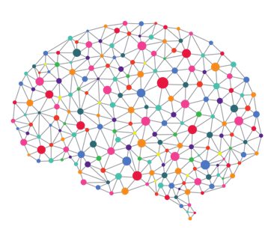
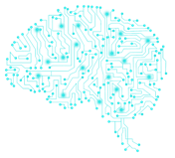
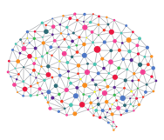



Is Transfer Learning Safe?
Transfer Learning lacks diversity
Users have very limited choices of Teacher models
Same Teacher
Help attacker exploit all Student models
Company A
Company B
Attacker

Slide 17
Attention and Transformer

Slide 18
Sequence to Sequence, Attention and Transformers
In the context of Machine Learning a sequence is an ordered data structure, whose successive elements are somehow correlated.
Examples:
Univariate Time Series Data:
Stock price of a company
Average daily temperature over a certain period of time
In general data which is tracked by sensors over time, e.g. accelaration, speed, energy-consumption, pressure, emissions, …
Multivariate Time Series Data:
For a specific product in an online-shop: Daily number of clicks, number of purchases, number of ratings, number of returns
Natural Language: The words in a sentence, section, article, …

Slide 19
Sequence to Sequence, Attention and Transformers
Image: Sequence of pixels
Video: Sequence of frames
The crucial property of sequences is the correlation between the individual datapoints.
This means that for each element (datapoint) of the sequence, information is not only provided by it’s individual feature-vector, but also by the neighboring datapoints.
For each element of the sequence, the neighboring elements are called context and we can understand an individual element by taking in account
it’s feature vector
the contextual information, provided by the neighbors

Slide 20
Sequence to Sequence Alignment: Encoder – Decoder Architecture
In an Encoder-Decoder architecture, the Encoder maps the input sequence X is converted to an intermediate representation, called context vector:
The entire information of the sequences is compressed in this vector.
The context vector is applied as input to the Decoder, which outputs a equivalent / related Sequence Y.
The input- and output-sequence need to be aligned.
Example architectures – next pages

Slide 21
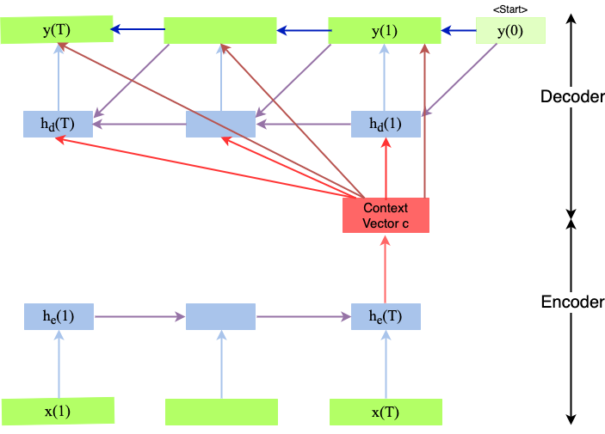
Some Sequence to Sequence Architectures Using Encoder– Decoder

Slide 22
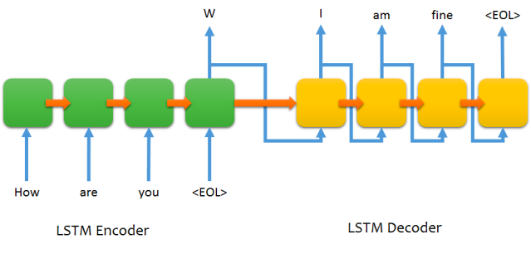
02
Attention and Transformers
Encoder-Decoder LSTM structure for chatting

Slide 23
Issues with Encoder - Decoder
The limitations of RNN’s
Encoder sequence cannot be memorized when input text is too long.
RNN’s tend to forget information from timesteps that are far behind (Vanishing gradients in RNNs).
Hence Decoder cannot decode it correctly.
Example – next page

Slide 24
Issues with Encoder - Decoder
“On offering to help the blind man, the man who then stole his car, had not, at that precise moment, had any evil intention, quite the contrary, what he did was nothing more than obey those feelings of generosity and altruism which, as everyone knows, are the two best traits of human nature and to be found in much more hardened criminals than this one, a simple car-thief without any hope of advancing in his profession, exploited by the real owners of this enterprise, for it is they who take advantage of the needs of the poor.” ~ Jose Saramago, “Blindnes.”If we just consider the word ‘he’ in the sentence, we see that ‘and’ and ‘is’ are the two words in close proximity to it.
Distance between bold words (representing attention are too long
So, it forgets older stuff. Apart from vanishing gradient, learning the relationship becomes difficult.

Slide 25
Better Solution - Use Attention
As humans, we do not try to remember everything at one time. We focus on some key words (The same is true in recognizing / processing visual objects)
We focus on certain key words (or key areas in an image) and then try to understand the text (or visual objects).
This is basically called putting Attention in key words / areas and then try to understand the text (or image).

Slide 26
Attention - 1
Consider the sentence – “Bark is very cute and he is a dog “
If we just consider the word ‘he’ in the sentence, we see that ‘and’ and ‘is’ are the two words in close proximity to it.
But these words do not give the word ‘he’ any context.
Rather the words ‘Bark’ and ‘dog’ are much more related to ‘he’ in the sentence.
From this, we understand that proximity is not always relevant but context is more relevant in a sentence.

Slide 27
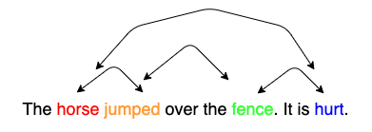
Attention – 2: Another Example
Attention in reading: When we read horse, we expect to encounter a verb, which is associated to horse. When we read jumped, we expect to encounter a word, which is associated to horse and jumped. When we read hurt, we expect to encounter a word, which is associated to jumped and hurt.

Slide 28
Basic Ideas - 2
When this sentence is fed to a computer, it considers each word as a token t, and each token has a word embedding V.
But these word embeddings have no context.
So the idea is to apply some kind of weighing or similarity to obtain final word embedding Y, which has more context than the initial embedding V.
In an embedding space, similar words appear closer together or have similar embeddings.
Such as the word ‘king’ will be more related to the word ‘queen’ and ‘royalty’, than with the word ‘zebra’. Similarly, ‘zebra’ will be more related to ‘horse’ and ‘stripes’, than with the word ‘emotion’.

Slide 29
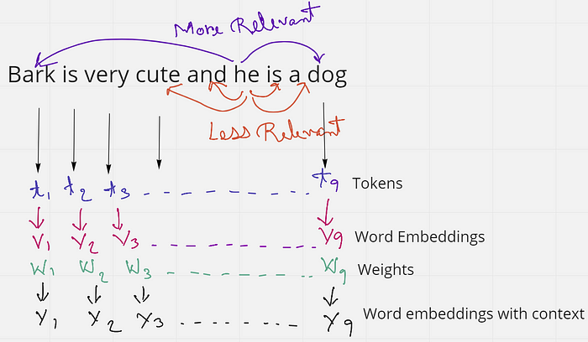
Basic Ideas - 3

Slide 30
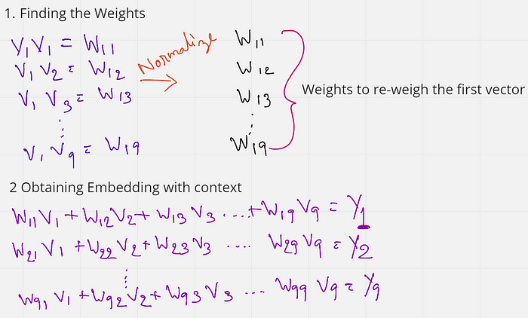
Better Embedding

Slide 31
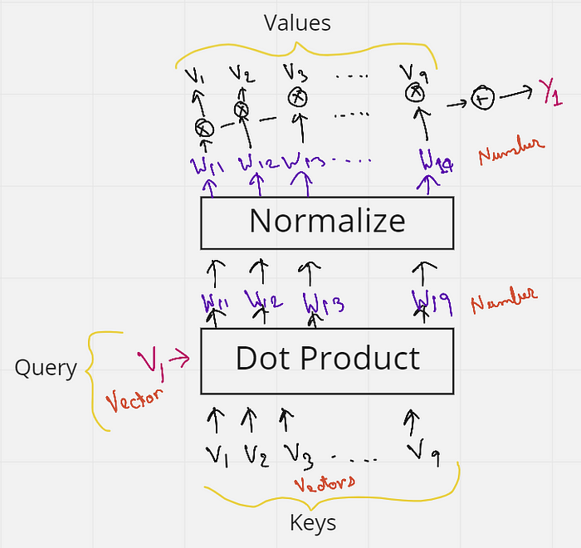
Better Embedding

Slide 32
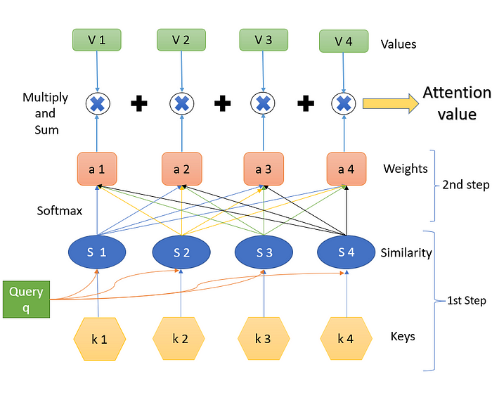
02
Attention
Encoder-Decoder machine translation
LSTM

Slide 33
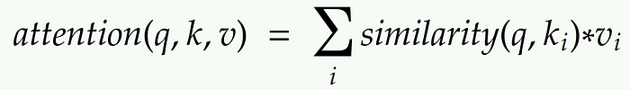
02
Equation for Attention

Slide 34
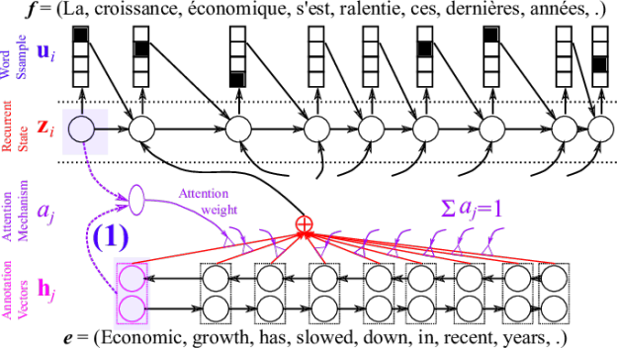
02
Attention and Transformers
Attention

Slide 35
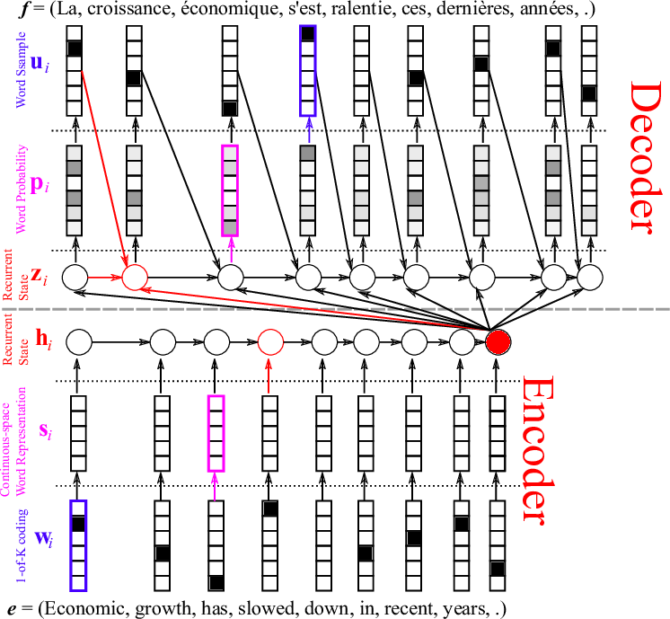
02
Attention and Transformers
Encoder-Decoder machine translation
LSTM

Slide 36

02
Attention and Transformers
Image caption generation using attention
A vector for each region
z⁰ is initial parameter, it is also learned
match
z⁰
0.7
CNN
filter
filter
filter
filter
filter
filter
filter
filter
filter
filter
filter
filter

Slide 37
02
Attention and Transformers
Image caption generation using attention
Word 1
A vector for each region
z⁰
z¹
Attention to
a region
weighted sum
CNN
filter
filter
filter
filter
filter
filter
0.7
0.1
0.1
0.1
0.0
0.0
filter
filter
filter
filter
filter
filter

Slide 38
02
Attention and Transformers
Image caption generation using attention
Word 1
Word 2
A vector for each region
z²
z⁰
z¹
weighted sum
CNN
filter
filter
filter
filter
filter
filter
0.0
0.8
0.2
0.0
0.0
0.0
filter
filter
filter
filter
filter
filter

Slide 39
02
Attention and Transformers
Image caption generation using attention
Kelvin Xu, Jimmy Ba, Ryan Kiros, Kyunghyun Cho, Aaron Courville, Ruslan Salakhutdinov, Richard Zemel, Yoshua Bengio,
“Show, Attend and Tell: Neural Image Caption Generation with Visual Attention”, ICML, 2015

Slide 40
02
Attention and Transformers
More new ideas:
ULM-FiT, pre-training, transfer learning in NLP
Recurrent models require linear sequential computation, hard to parallelize. ELMo, bidirectional LSTM.
In order to reduce such sequential computation, several models based on CNN are introduced, such as ConvS2S and ByteNet. Dependency for ConvS2S needs linear depth, and ByteNet logarithmic.
The transformer is the first transduction model relying entirely on self-attention to compute the representations of its input and output without using RNN or CNN.

Slide 41
02
What is a Transformer?
A Transformer in general consists of an Encoder and a Decoder stack. The Encoder is a stack of Encoder-blocks. The Decoder is a stack of Decoder-blocks.
Both, Encoder- and Decoder-blocks are Transformer blocks.
In general, a Transformer Block is defined to be any architecture, designed to process a connected set of units - such as the tokens in a sequence or the pixels in an image - where the only interaction between units is through self-attention.

Slide 42
02
What is a Transformer?
Transformers provides APIs and tools to easily download and train state-of-the-art pretrained models.
Using pretrained models can reduce your compute costs and save you the time and resources required to train a model from scratch.
These models support common tasks in different modalities, such as: NEXT SLIDE

Slide 43
02
What is a Transformer?
📝NLP- Natural Language Processing: text classification, named entity recognition, question answering, language modeling, summarization, translation, multiple choice, and text generation.
🖼️ Computer Vision: image classification, object detection, and segmentation. 🗣️ Audio: automatic speech recognition and audio classification. 🐙 Multimodal: table question answering, optical character recognition, information extraction from scanned documents, video classification, and visual question answering.

Slide 44

02
Attention and Transformers
Transformer

Slide 45
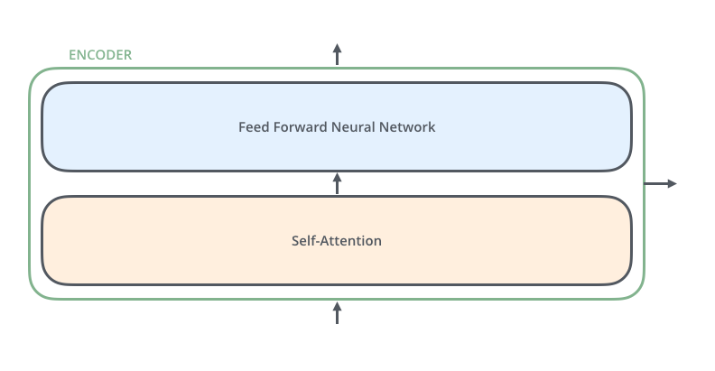
02
Attention and Transformers
An Encoder Block: same structure, different parameters

Slide 46
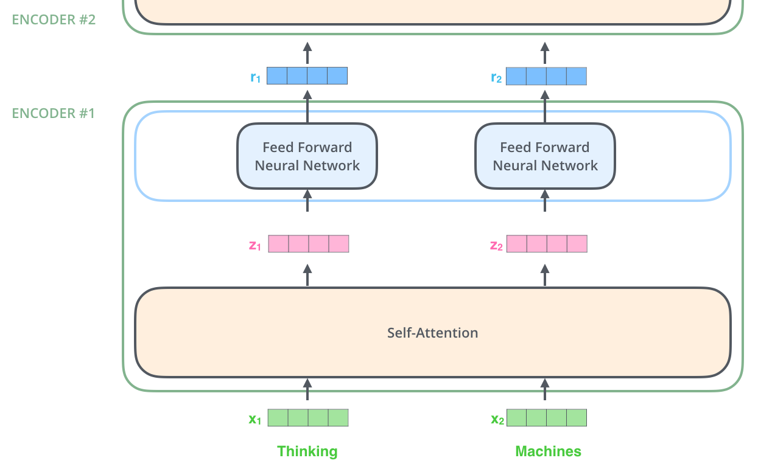
02
Attention and Transformers
Encoder
Note: The ffnn is independent
for each word.
Hence can be parallelized.

Slide 47

02
Attention and Transformers
Self Attention
512 → 4
64
64 → 3
512
First we create three vectors
by multiplying input embedding
(1x512)
x_{i} with three matrices (64x512):
q_{i} = x_{i} W^{Q}
K_{i} = x_{i} W^{K}
V_{i} = x_{i} W^{V}
Notes:
Dimension of q,k,v

Slide 48
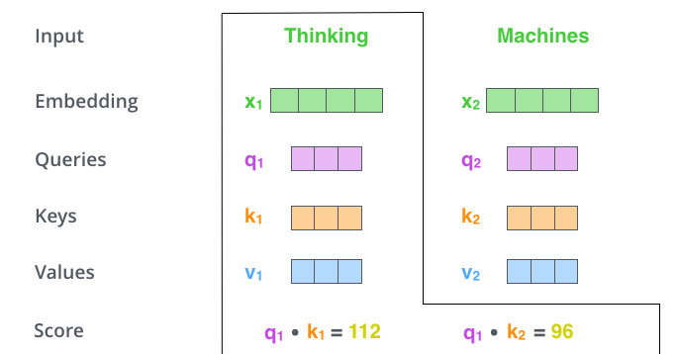
02
Attention and Transformers
Self Attention
Now we need to calculate
a score to determine how
much focus to place on other
Parts of the input.

Slide 49


02
Attention and Transformers
Self Attention
Formula
64x64
64x512
~
~
d_{k}=64 is dimension of key vector
z₁= 0.88v₁+ 0.12v₂
Notes:
v~

Slide 50
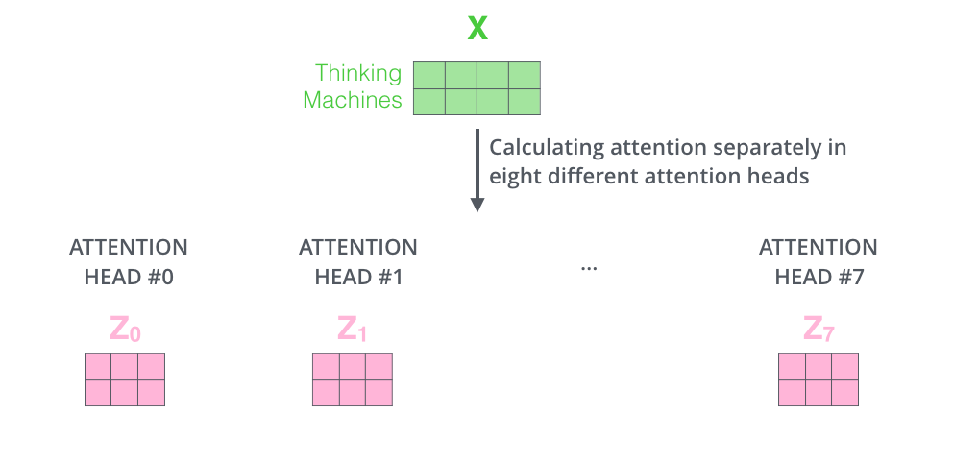
02
Attention and Transformers
Multiple heads
It expands the model’s ability to focus on different positions.
It gives the attention layer multiple “representation subspaces”

Slide 51
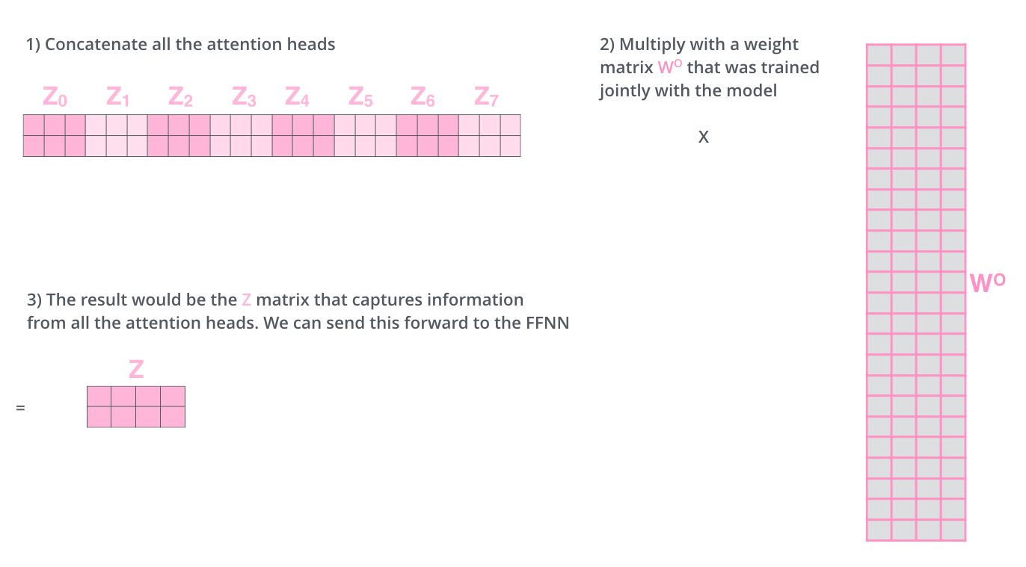
02
Attention and Transformers
4
The output is expecting only a 2x4 matrix, hence,
24
If you want some more intuition on attention: watch https://www.youtube.com/watch?v=-9vVhYEXeyQ
Notes:
What about order? What happens if scale of these vectors are out of proportion?

Slide 52
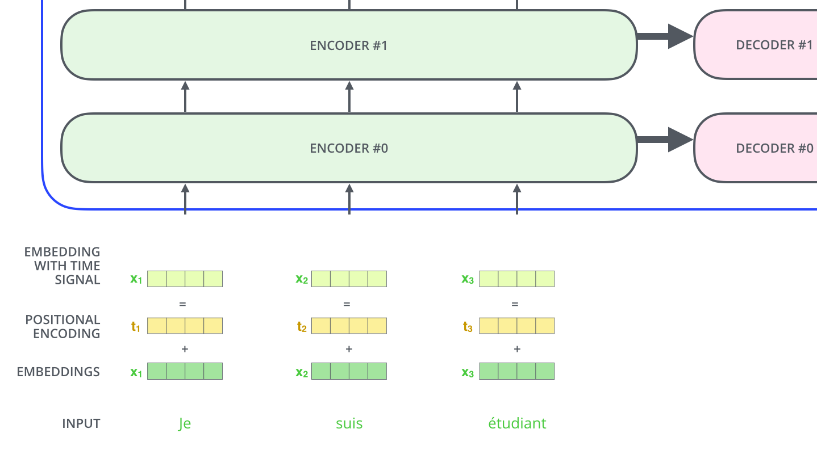
02
Attention and Transformers
Representing the input order (positional encoding)
The transformer adds a vector to each input embedding. These vectors follow a specific pattern that the model learns, which helps it determine the position of each word, or the distance between different words in the sequence. The intuition here is that adding these values to the embedings provides meaningful distances between the embedding vectors once they’re projected into Q/K/V vectors and during dot-product attention.
More on positional encoding: https://kazemnejad.com/blog/transformer_architecture_positional_encoding/

Slide 53

02
Attention and Transformers
Add and Normalize
In order to regulate the computation, this is a normalization layer so that each feature (column) have the same average and deviation.

Slide 54
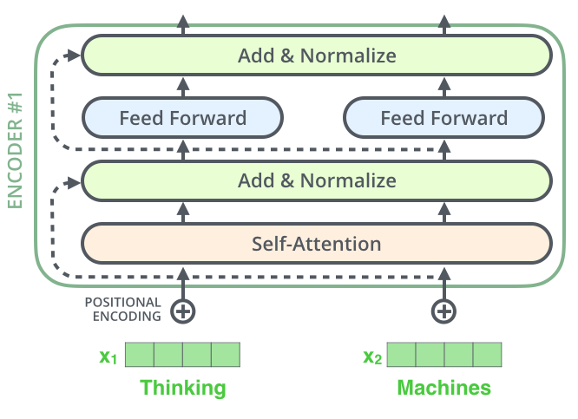
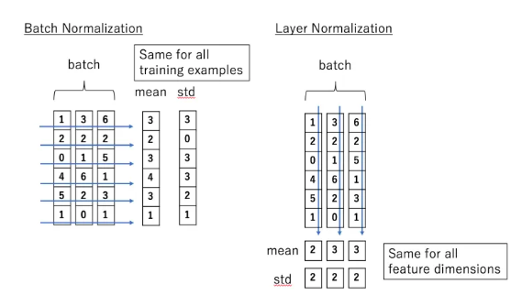
02
Attention and Transformers
Layer Normalization (Hinton)
Layer normalization normalizes the inputs across the features.

Slide 55

The complete transformer
02
Attention and Transformers
The encoder-decoder attention is just like self attention, except it uses K, V from the top of encoder output, and its own Q

Slide 56
02
Attention and Transformers
Note: In decoder, the input is “incomplete”when calculating self-attention.
The solution is to set future unknown values with “-inf”.

Slide 57
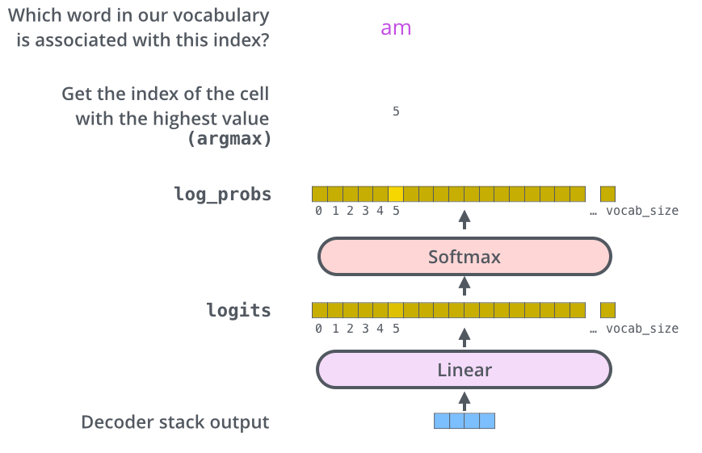
02
Attention and Transformers
Decoder's
Output
Linear
Layer

Slide 58
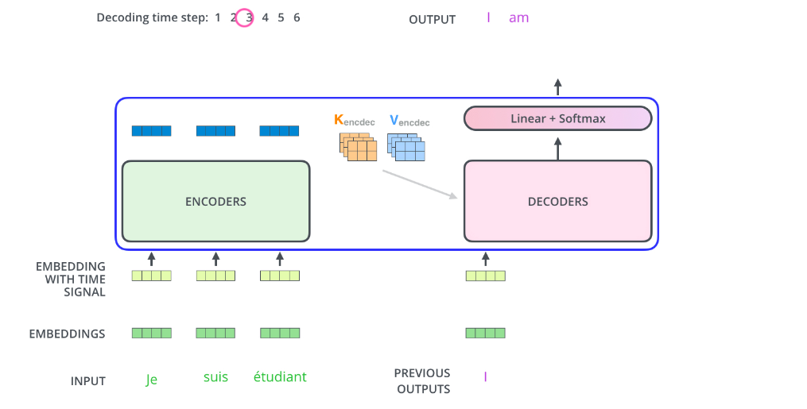
Attention and Transformers
How it works
02
Decoder’s
Output
Linear
Layer
But what about
Self-attention?

Slide 59
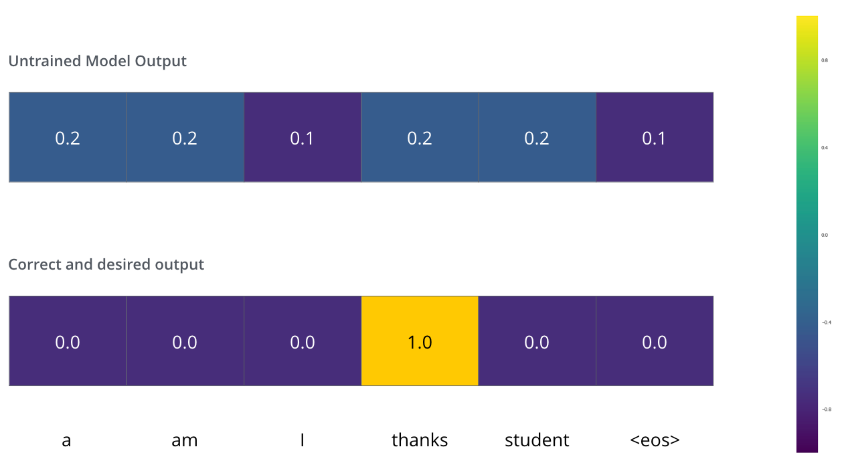
02
Attention and Transformers
Training and the Loss Function
We can use cross
Entropy.
We can also optimize two words at a time: using BEAM search: keep a few alternatives for the first word.

Slide 60
02
Attention and Transformers
Cross Entropy and KL (Kullback-Leibler) divergence
Entropy: E(P) = - Σ_{i}P(i)logP(i) - expected prefix-free code length (also optimal)
Cross Entropy: C(P) = - Σ_{i}P(i) log Q(i) – expected coding
length using optimal code for Q
KL divergence:
D_{KL}(P || Q) = Σ_{i}P(i)log[P(i)/Q(i)] = Σ_{i}P(i)[logP(i) – logQ(i)], extra bits to code
using Q rather than P
JSD(P||Q) = ½ D_{KL}(P||M)+ ½ D_{KL}(Q||M), M= ½ (P+Q), symmetric KL
* JSD = Jensen-Shannon Divergency

Slide 61
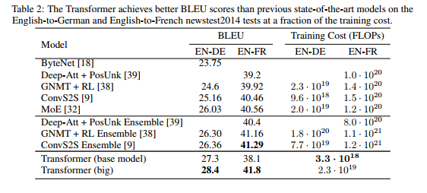
02
Attention and Transformers
Transformer Results

Slide 62
Next Lecture: Pretraining
02
Attention and Transformers
BERT
GPT

